Slide 1
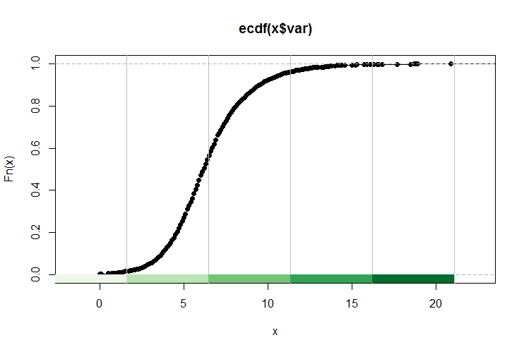
Week 10:Normality testing; Chi-square; Non-parametric tests
Geog4300: Harper
October 23, 2025

Slide 2
Today’s plan
Testing for normality
If data is not normally distributed –Wilcoxon test
If the two variables being tested are categorical rather than continuous – Chi-squared test
Introduce Lab 4

Slide 3
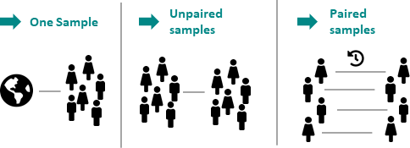
Continuous
σ known and n > 30
Continuous
σ unknown or n < 30
Use Z-test and Z statistic. Standard error = SE = σ/sqrt(n)
Use t-test and t statistic. Standard error = SE = s/sqrt(n-1)
Notes:
Reminder: One sample: We use a t-test, unless the actual standard deviation is known and n>30, then we use the z score. The difference in practice is very small.

Slide 4
Two sample t-tests
Key question #1: Is the variance in both samples even or uneven?
Key question #2: Are the samples independent or paired?
Key question #3: Are the samples parametric (normal) or non-parametric?
How do we test for normality?

Slide 5
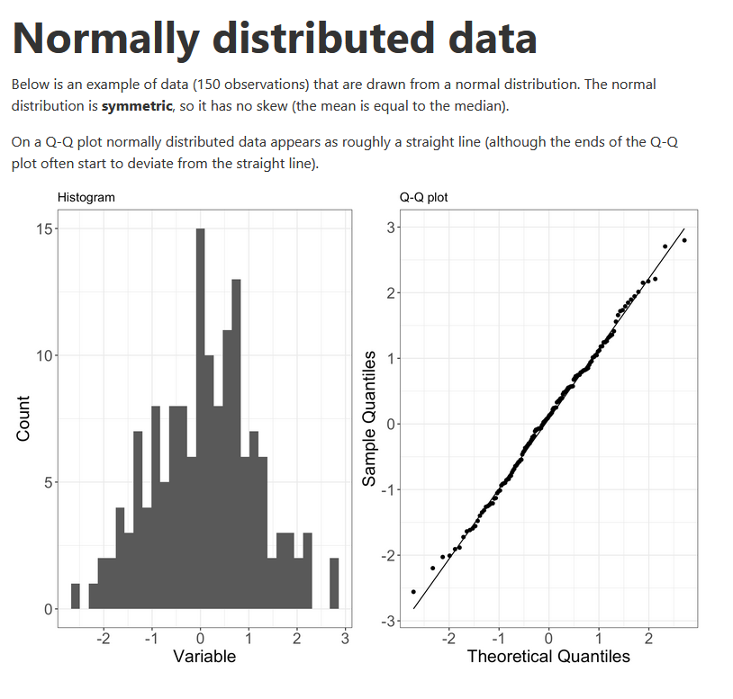
How do we assess normality?
Histograms
QQ plots
Normality tests
https://www.ucd.ie/ecomodel/Resources/QQplots_WebVersion.html
Notes:
Alternative hypothesis is usually what you’re trying to prove.

Slide 6
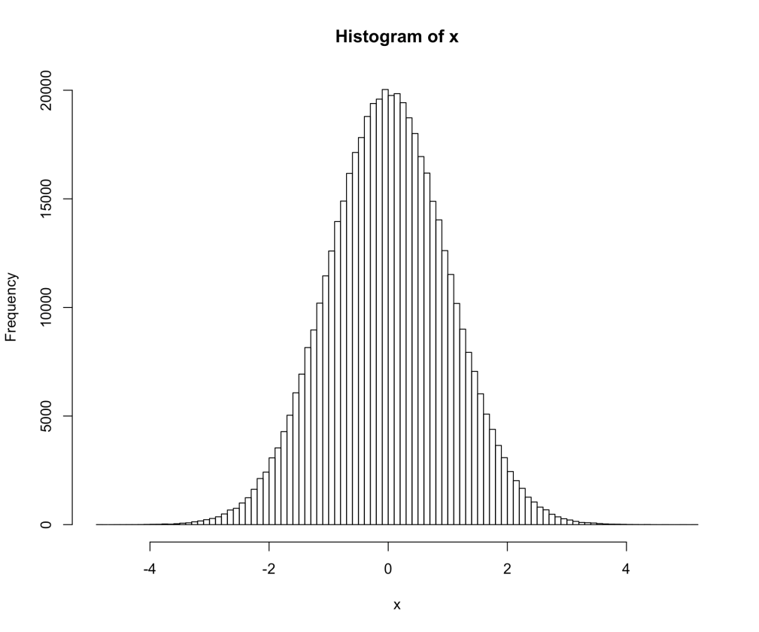
The Shapiro-Wilk normality test compares the actual distribution to a normal distribution, measuring the gap between them at multiple points.
There are other normality test, but this one has more power when compared to other tests, especially with smaller (<50) samples.

Slide 7
Let’s try this in R

Slide 8
What if your samples aren’t normal?
Number of named Atlantic tropical storms, years
Random sample of hurricanes in El Nino and La Nina years—11 each
You need a non-parametric test with data that’s not normal.
El Nino | La Nina
0 | 4
5 | 4
1 | 12
3 | 2
4 | 17
1 | 7
2 | 6
2 | 10
0 | 4
2 | 8
4 | 6

Slide 9
Wilcoxon Rank Sum test
Number of named Atlantic tropical storms, years
Question: Is the number of Atlantic storms significantly different in El Nino years compared to La Nina years?
El Nino | La Nina
0 | 4
5 | 4
1 | 12
3 | 2
4 | 17
1 | 7
2 | 6
2 | 10
0 | 4
2 | 8
4 | 6
See lecture video for the details of what’s going on ‘under the hood’

Slide 10
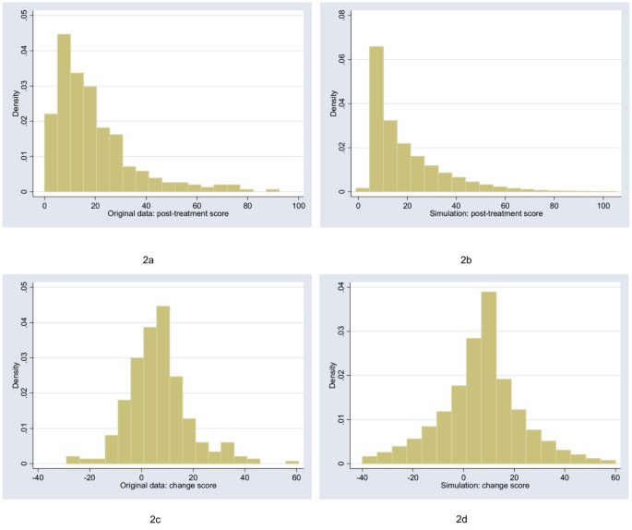
Two sample t-tests
Number of named Atlantic tropical storms, years
Key question #3: Are the samples parametric (normal) or non-parametric?
El Nino | La Nina
0 (1.5) | 4 (12)
5 (15) | 4 (12)
1 (3.5) | 12 (21)
3 (9) | 2 (6.5)
4 (12) | 17 (22)
1 (3.5) | 7 (18)
2 (6.5) | 6 (16.5)
2 (6.5) | 10 (20)
0 (1.5) | 4 (12)
2 (6.5) | 8 (19)
4 (12) | 6 (16.5)
W₁ = 77.5 W₂ = 175.5
Notes:
Alternative hypothesis is usually what you’re trying to prove.

Slide 11
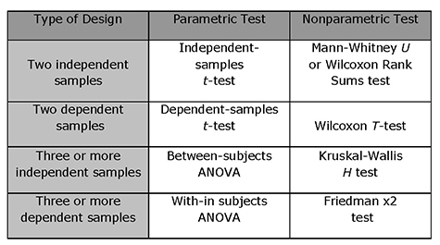

Slide 12
Characteristics of the data | Tests and test statistics | Standard Error
Continuous; one sample: σ known and n > 30 | One-sample z-test; Z | SE = σ/sqrt(n)
Data is a proportion | Diff. of proportions
Continuous; one sample: σ unknown or n < 30 | One-sample t-test; t; | SE = s/sqrt(n-1)
Continuous; two samples | Student’s t-test for difference of means
Continuous; paired samples | Paired t-test
Continuous; more than two samples | ANOVA
Discrete; two variables; counts | Chi-square, goodness of fit
Continuous; two or more variables | Regression
You are here

Slide 13
Tests of difference
What is the specific purpose of this test? When would you use it rather than another one?
One sample t-test
Two sample t-test
Two sample paired t-test
Non-parametric (Wilcoxon) t-test
Difference test between two proportions

Slide 14
Dependent Variable | Independent Variable(s) | Test | Example hypotheses
Quantitative / ratio | Categorical/ nominal (2 values) | (n > 30): t-test for independent samples; | “The average speed of cars has changed between the times that speed cameras were operating and the times that they were not.”
 |  | (n < 30): Wilcoxon rank sum (non-parametric)
 | Categorical/ nominal (more than 2 values) | ANOVA | “The amount the average household gives to charity each year depends on whether the resident lives in the East, the Midwest, the South, or the West.”
Categorical | Categorical | Chi-squared test | “The typical denomination of churches depends on the state (Utah has more LDS churches, New York has more Roman Catholic churches)”
Quantitative | Quantitative (1 variable) | Correlation/ regression | “The median household income of a census tract is a good indicator of the voter turnout percentage at primary elections.”
Quantitative | Quantitative (more than one variable) | Multiple regression | “Student test scores are a function of the median income, amount spent per capita on education, and average number of years of schooling of teachers in a census tract.”

Slide 15
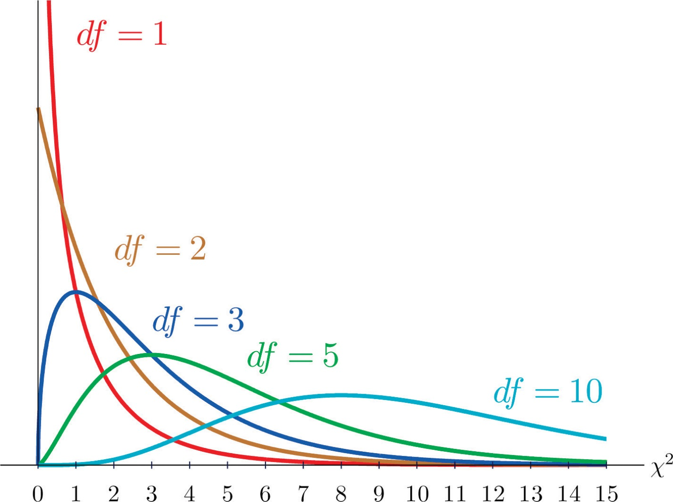
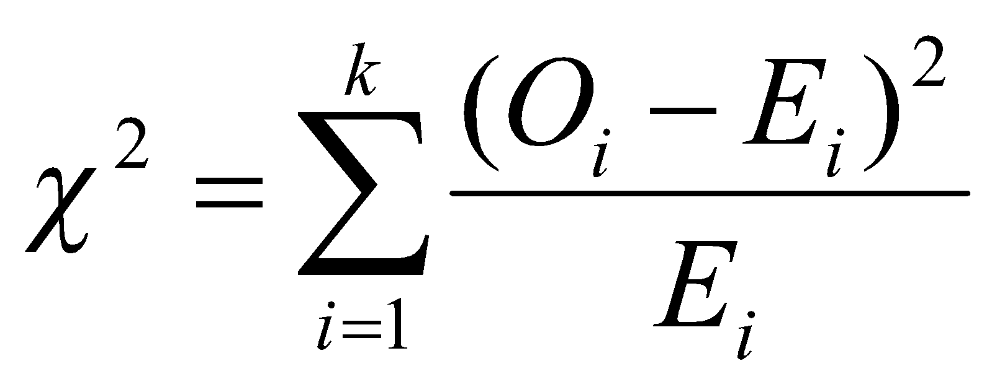
Chi-square tests
For two categorical variables
O_{i} = Observed value for observation i
E_{i} = Expected value for observation i
k = Number of observations in all groups
Notes:
T-test: independent variable vs dependent variable, work when you have a categorical variable and nominal or ratio data.

Slide 16

An example
Does your football team tell you something
about your Thanksgiving meal preference
(dark/white meat or tofurkey)?
What are the independent and dependent variable?
Independent: Football team (Nominal)
Dependent: Meal choice (Nominal)
Notes:
Alternative hypothesis is usually what you’re trying to prove.

Slide 17
ESPN surveyed 85 football fans…
 | White meat | Dark meat | Tofu-rkey | TOTAL
Lions | 15 | 25 | 3 | 43
Cowboys | 25 | 10 | 7 | 42
TOTAL | 40 | 35 | 10 | 85
This contingency table shows turkey preference as a function of (“contingent upon”) team preference.
Degrees of freedom = (#rows -1)*(#cols-1) = (2-1)(3-1) = 2
Notes:
Alternative hypothesis is usually what you’re trying to prove.

Slide 18
Calculating expected values
 | White meat | Dark meat | Tofu-rkey | TOTAL
Lions |  |  |  | 43
Cowboys |  |  |  | 42
TOTAL | 40 (47%) | 35 (41%) | 10 (12%) | 85
Notes:
Alternative hypothesis is usually what you’re trying to prove.

Slide 19
Calculating expected values
 | White meat | Dark meat | Tofu-rkey | TOTAL
Lions | =.47 * 43 = 20.2 | =.41 * 43 = 17.7 | =.12 * 43 = 5.1 | 43
Cowboys | =.47 * 42 = 19.8 | =.41 * 42 = 17.3 | =.12 * 42 = 4.9 | 42
TOTAL | 40 (47%) | 35 (41%) | 10 (12%) | 85
Notes:
Alternative hypothesis is usually what you’re trying to prove.

Slide 20
What’s the chi-square statistic?
 | White meat | Dark meat | Tofu-rkey | TOTAL
Lions | O = 15 E = 20.2 | O = 25 E = 17.7 | O = 3 E = 5.1 | 43
Cowboys | O = 25 E = 19.8 | O = 10 E = 17.3 | O = 7 E = 4.9 | 42
TOTAL | 40 (47%) | 35 (41%) | 10 (12%) | 85
χ² = (15-20.2)² / 20.2 + … (7-4.9)² / 4.9
Critical value for 2 degrees of freedom is 5.99
Notes:
Alternative hypothesis is usually what you’re trying to prove.

Slide 21
You try it!
A survey was done of Manhattan residents to see if their most common transportation method was related to their income. Here are the results:
 | Car | Transit | Walk/bike | Total
Low income | 58 | 21 | 36 | 115
Moderate income | 199 | 49 | 64 | 312
High income | 205 | 32 | 29 | 266
Total | 462 | 102 | 129 | 693
Using a chi-square test, check to see if these results show a difference between these groups. You may want to enter this table in Excel to run this analysis.
Notes:
Alternative hypothesis is usually what you’re trying to prove.

Slide 22
Writing up results
Results of statistical analysis generally focus on direction, magnitude, and significance.
For a chi-square test, calculate the percentage of each income group in each transit type. Then write a paragraph that summarizes your findings. What pattern do you see of higher or lower rates? What is the magnitude of the key differences? Is it statistically significant?
 | Car | Transit | Walk/bike | Total
Low income | 58 | 21 | 36 | 115
Moderate income | 199 | 49 | 64 | 312
High income | 205 | 32 | 29 | 266
Total | 462 | 102 | 129 | 693
Notes:
Alternative hypothesis is usually what you’re trying to prove.

